Slide 1

Department of Computer Science Engineering
“VersoAugmented Reality”
Guided By. Presented By.
Prof. S.R.Sontakke Ms. Sushma Deotale
Ms. Vaishnavi Deshmukh
Ms. Sakshi Charthal
Ms. Himani Umrtkarar

Slide 2
Introduction
Virtual Reality & Augmented Reality is a trending technology that gives excellent scope for this project.
The biggest advantage of Augmented Reality is that it creates unique digital experiences that blend the best of digital and physical worlds.
Virtual reality (VR) and augmented reality (AR) will help students understand and interact more effectively.
We are used VR & AR-based educational approaches and experiences in the specific field of engineering studies.

Slide 3
Literature Survey
Alejandro Alvarez-Marin ,“Augmented Reality and Engineering Education ”
This article presents a systematic review of the state of the AR technology applied to education. Augmented reality (AR) for learning is a relevant topic that has recently received considerable attention. However, the current literature lacks a survey of AR-based educational approaches and experiences in the specific studies.
Awais Khan Jumani , “Virtual Reality and Augmented Reality for Education ”
VR has recently now interfered in every part of life. We cannot visualize life without the use of VR technology. we include the importantance and introduce the history of VR. Further, we discuss the 360-degree and 3D videos explicit in VR as well as uses of volumetric 2D/3D with projection. Furthermore, AR-based learning in education is the most important and easy-to-understand thing.

Slide 4
M. Billinghurst and A. Duenser, “Augmented reality in the classroom,”
Evaluations of AR experiences in an educational setting provide insights into how this technology can
enhance traditional learning models and what obstacles stand in the way of its broader use.
J. Martín-Gutiérrez and M. Meneses, “Applying augmented reality in engineering education to improve academic performance & student motivation,
This paper introduces an Augmented Reality application for teaching practice of education. We have
used these AR-manuals and the classical ones observing an improvement in both learning and
students´ motivation.The augmented information consists in 3D models, animations and sound
which are superimposed over real objects helping the students in specific tasks’ training.

Slide 5
Implementation
Technology
AR technology allows real-time augmentation and this augmentation takes place within the context of the environment. Animations, images, videos, and 3D models may be used and users can see objects in natural.
The technologies that we will used in this project i.e.
1. C#
2. Python

Slide 6
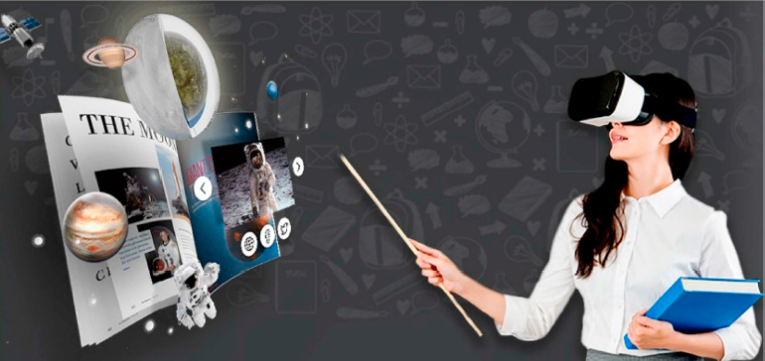

Slide 7
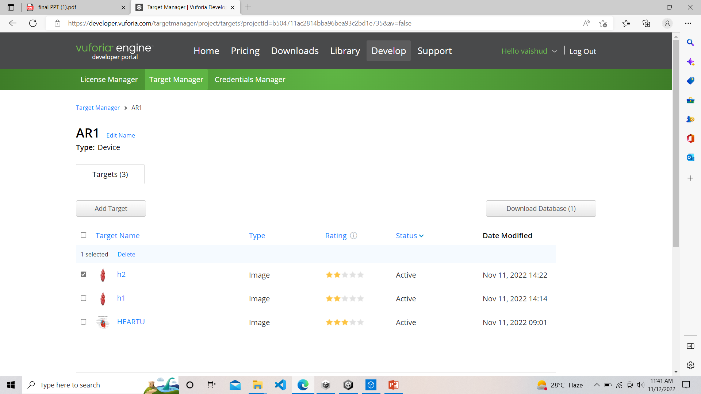

Slide 8
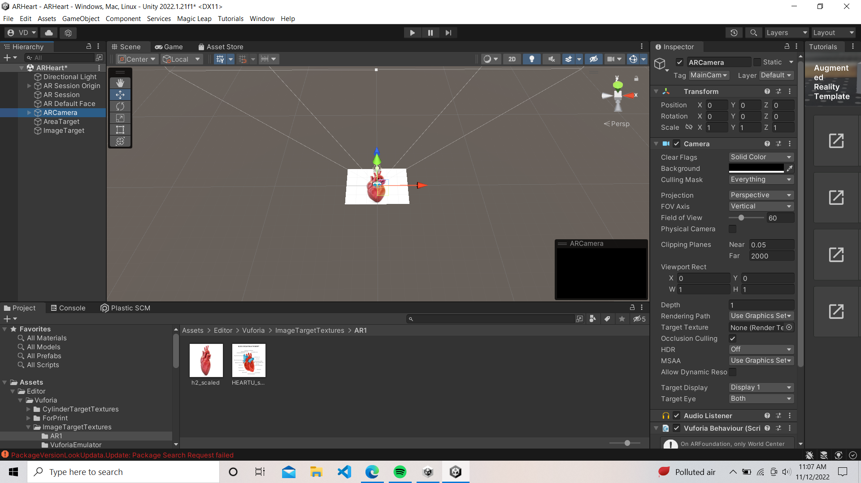

Slide 9
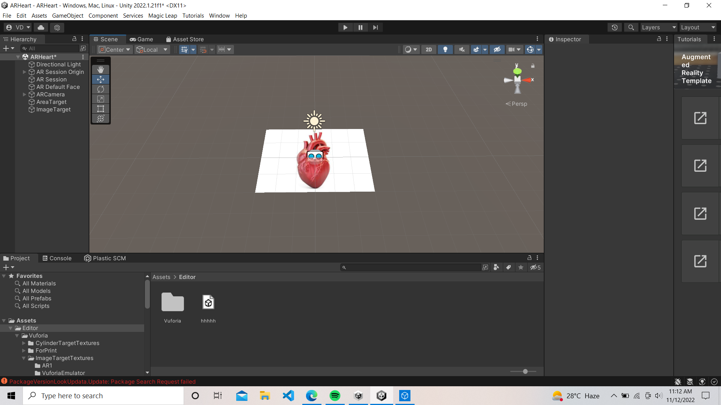

Slide 10
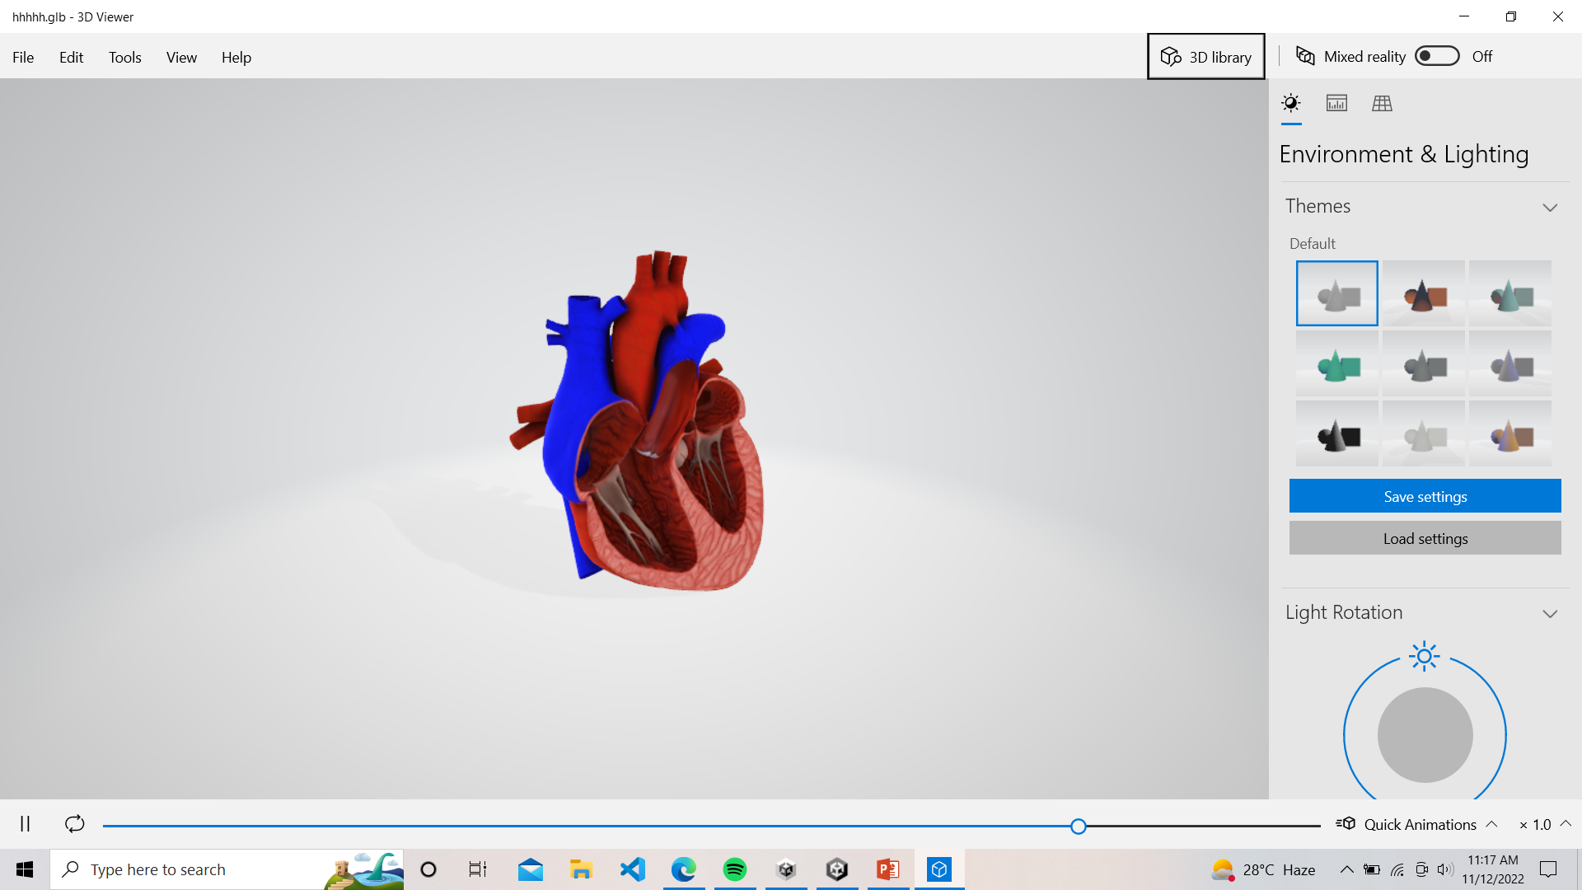

Slide 11
Software
The Software that we used in this project i.e.
1. Unity
2. Vuforia
3. UWP
4. Android
5. Windows

Slide 12
Modules
1. Biology
1. Heart
2. Respiratory System
3. Nurvous System
4. Nephron
2. Chemistry
1. Chemical Reaction
3. Solar Planet

Slide 13


